Slide 1
High Nitrogen “Center Triangle” Testing
Shelter Island Town
Test Results and What They Mean
2024

Slide 2
Tests conducted for Nitrate, Nitrite, Ammonia, Coliform, e. Coli and Anionic Detergent
Nitrate: NO3- in groundwater sources: septic tanks, private sewage disposal systems, fertilized soil, landfills
Nitrite: NO2- food additive and converts to NO3- through oxidation
Ammonia: Indicates a local septic system is malfunctioning
Coliform: Bacterial contamination from septic system leakage, poor well maintenance
e.Coli: Bacterial indicator of septic system leakage
Anionic Detergent: Dish soap, shampoo, toothpaste. Indicators of migrating septic waste

Slide 3
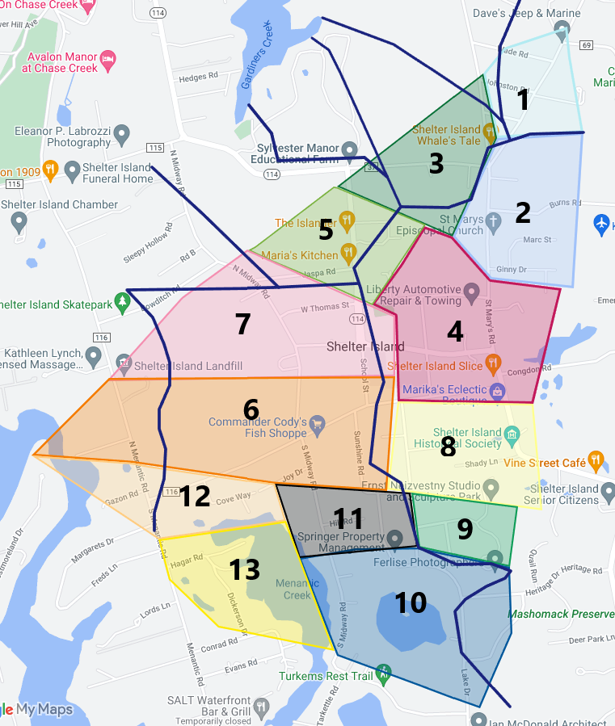
148 Homes requested testing
400 Homes invited to participate
Areas were separated into watershed zones
Watershed: An area of land where water moves in a specific direction out towards salt water interfaces
Results from private testing lab were received anonymously by the town by zones only
Homeowners received their own results

Slide 4
Why were tests conducted?
Verify the extent of nitrite/nitrate contamination in the center triangle.
Gain understanding of where other water contaminants might be found.
Confirm and identify priority areas for IA system installation.
Provide water quality information to the board and to community members.

Slide 5
Regulated Limits for Potable Water
Test | Maximum Contamination Level MCL | How MCL’s are determined
Nitrate | 10 mg/L | EPA sets MCL State/Town set Action Level Health Concerns: Drinking and Cooking only
Nitrite | 1 mg/L
Ammonia | Not established | Indicator
Coliform | Pass/Fail | EPA - widespread environmental contaminant
e.Coli | Pass/Fail | EPA - widespread fecal contaminant
Detergents | Not established | Indicator

Slide 6
NITRATE Test Results
At or above MCL (10 mg/L) 8 wells In Zones 2, 8, 9 & 11
At Action Level (5-10 mg/L) 75 wells All Zones (except 13)
Below Action Level (<5 mg/L) 94 wells Nitrates

Slide 7
High NITRATE Health Implications (10 mg/L and 5 mg/L)
Interfere with O2 Metabolism
Blue Baby Syndrome at MCL - Lack of O2 in blood stream
Coma, death
Increased heart rate, nausea, headaches, cramps
Drinking water with 5 to 10 mg/L has been correlate * with:
Thyroid disease
Neural tube birth defects
Thyroid, colon, kidney, bladder and ovarian cancers
* Correlation does not imply causality. Adverse health effects could be caused by other contaminants in septic waste and/or fertilizers/pesticides.

Slide 8
NITRITE Test Results
Below Action Level (.5 - 1 mg/L) 1 well .02 mg/L Zone 1
High NITRITE Health Implications
Similar to NITRATES with similar metabolic processes
Health danger at much lower level than NITRATE
High levels are correlated with an increased risk of cancer
Indicates a nearby septic system is malfunctioning

Slide 9
AMMONIA (NH3) Test Results
Detection (<1 mg/L) 1 well 2 mg/L
Health Implications
None at this level
NH3 Toxic to freshwater organisms and aquatic life .53 - 22.8 mg/L
If found, suggests that an owner’s or neighbor’s septic system may be malfunctioning.

Slide 10
COLIFORMS AND E COLI Test Results
eColi 1 well positive Zone 8
Coliforms 10 wells positive Zones 2, 5, 6, 8, 10 & 11
Health Implications
Coliforms rarely cause disease but indicate presence of other bacterial pathogens such as eColi which can cause serious illness including nausea, headaches, fever.

Slide 11
DETERGENTS (MBA) Test Results
< 0.1 mg/L All Wells Indicates presence in aquifer
Health Implications
Can cause Irritation, inflammation or eczema flare-ups
Can contaminate water supplies with heavy metals such as arsenic, and cadmium
1,4 dioxane (carcinogen) common ingredient in detergents and shampoos

Slide 12
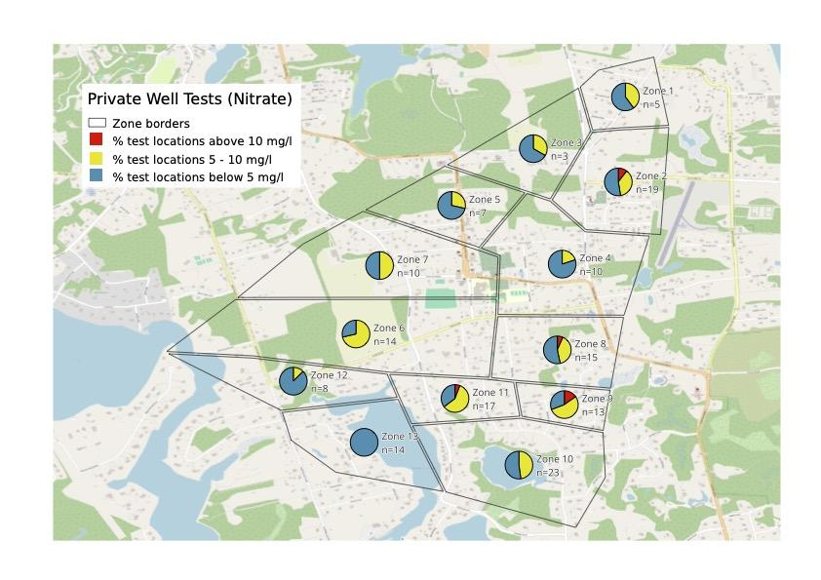
Histogram of Nitrate Results
Do not rely on the test results for the zones to judge your well water quality. Get your water tested!

Slide 13
Corrective Measures
Test well water annually -Private companies or SCHD ($100)
Identify location of septic systems, inspect and service regularly
Install high efficiency water filtration system in sinks or whole house system. Make sure they filter nitrates, nitrates and PFOS/PFOA’s (forever chemicals)
Drink bottled water if necessary. However, see the following advisement:
https://www.cnn.com/2024/01/08/health/bottled-water-nanoplastics-study-wellness/index.html

Slide 14
What is the Town doing to safeguard your water?
Using data from this study and other data collected from around the Island to get a snapshot of water quality
Setting up a study in near-shore areas and where salt water intrusion is making well water non-potable.
Considering a municipal water distribution center for people with non-potable water to fill containers
Discussing public water supply system to critical areas
Advanced septic system grant program to reduce nitrogen

Slide 15
Questions, comments, considerations?

