Slide 1
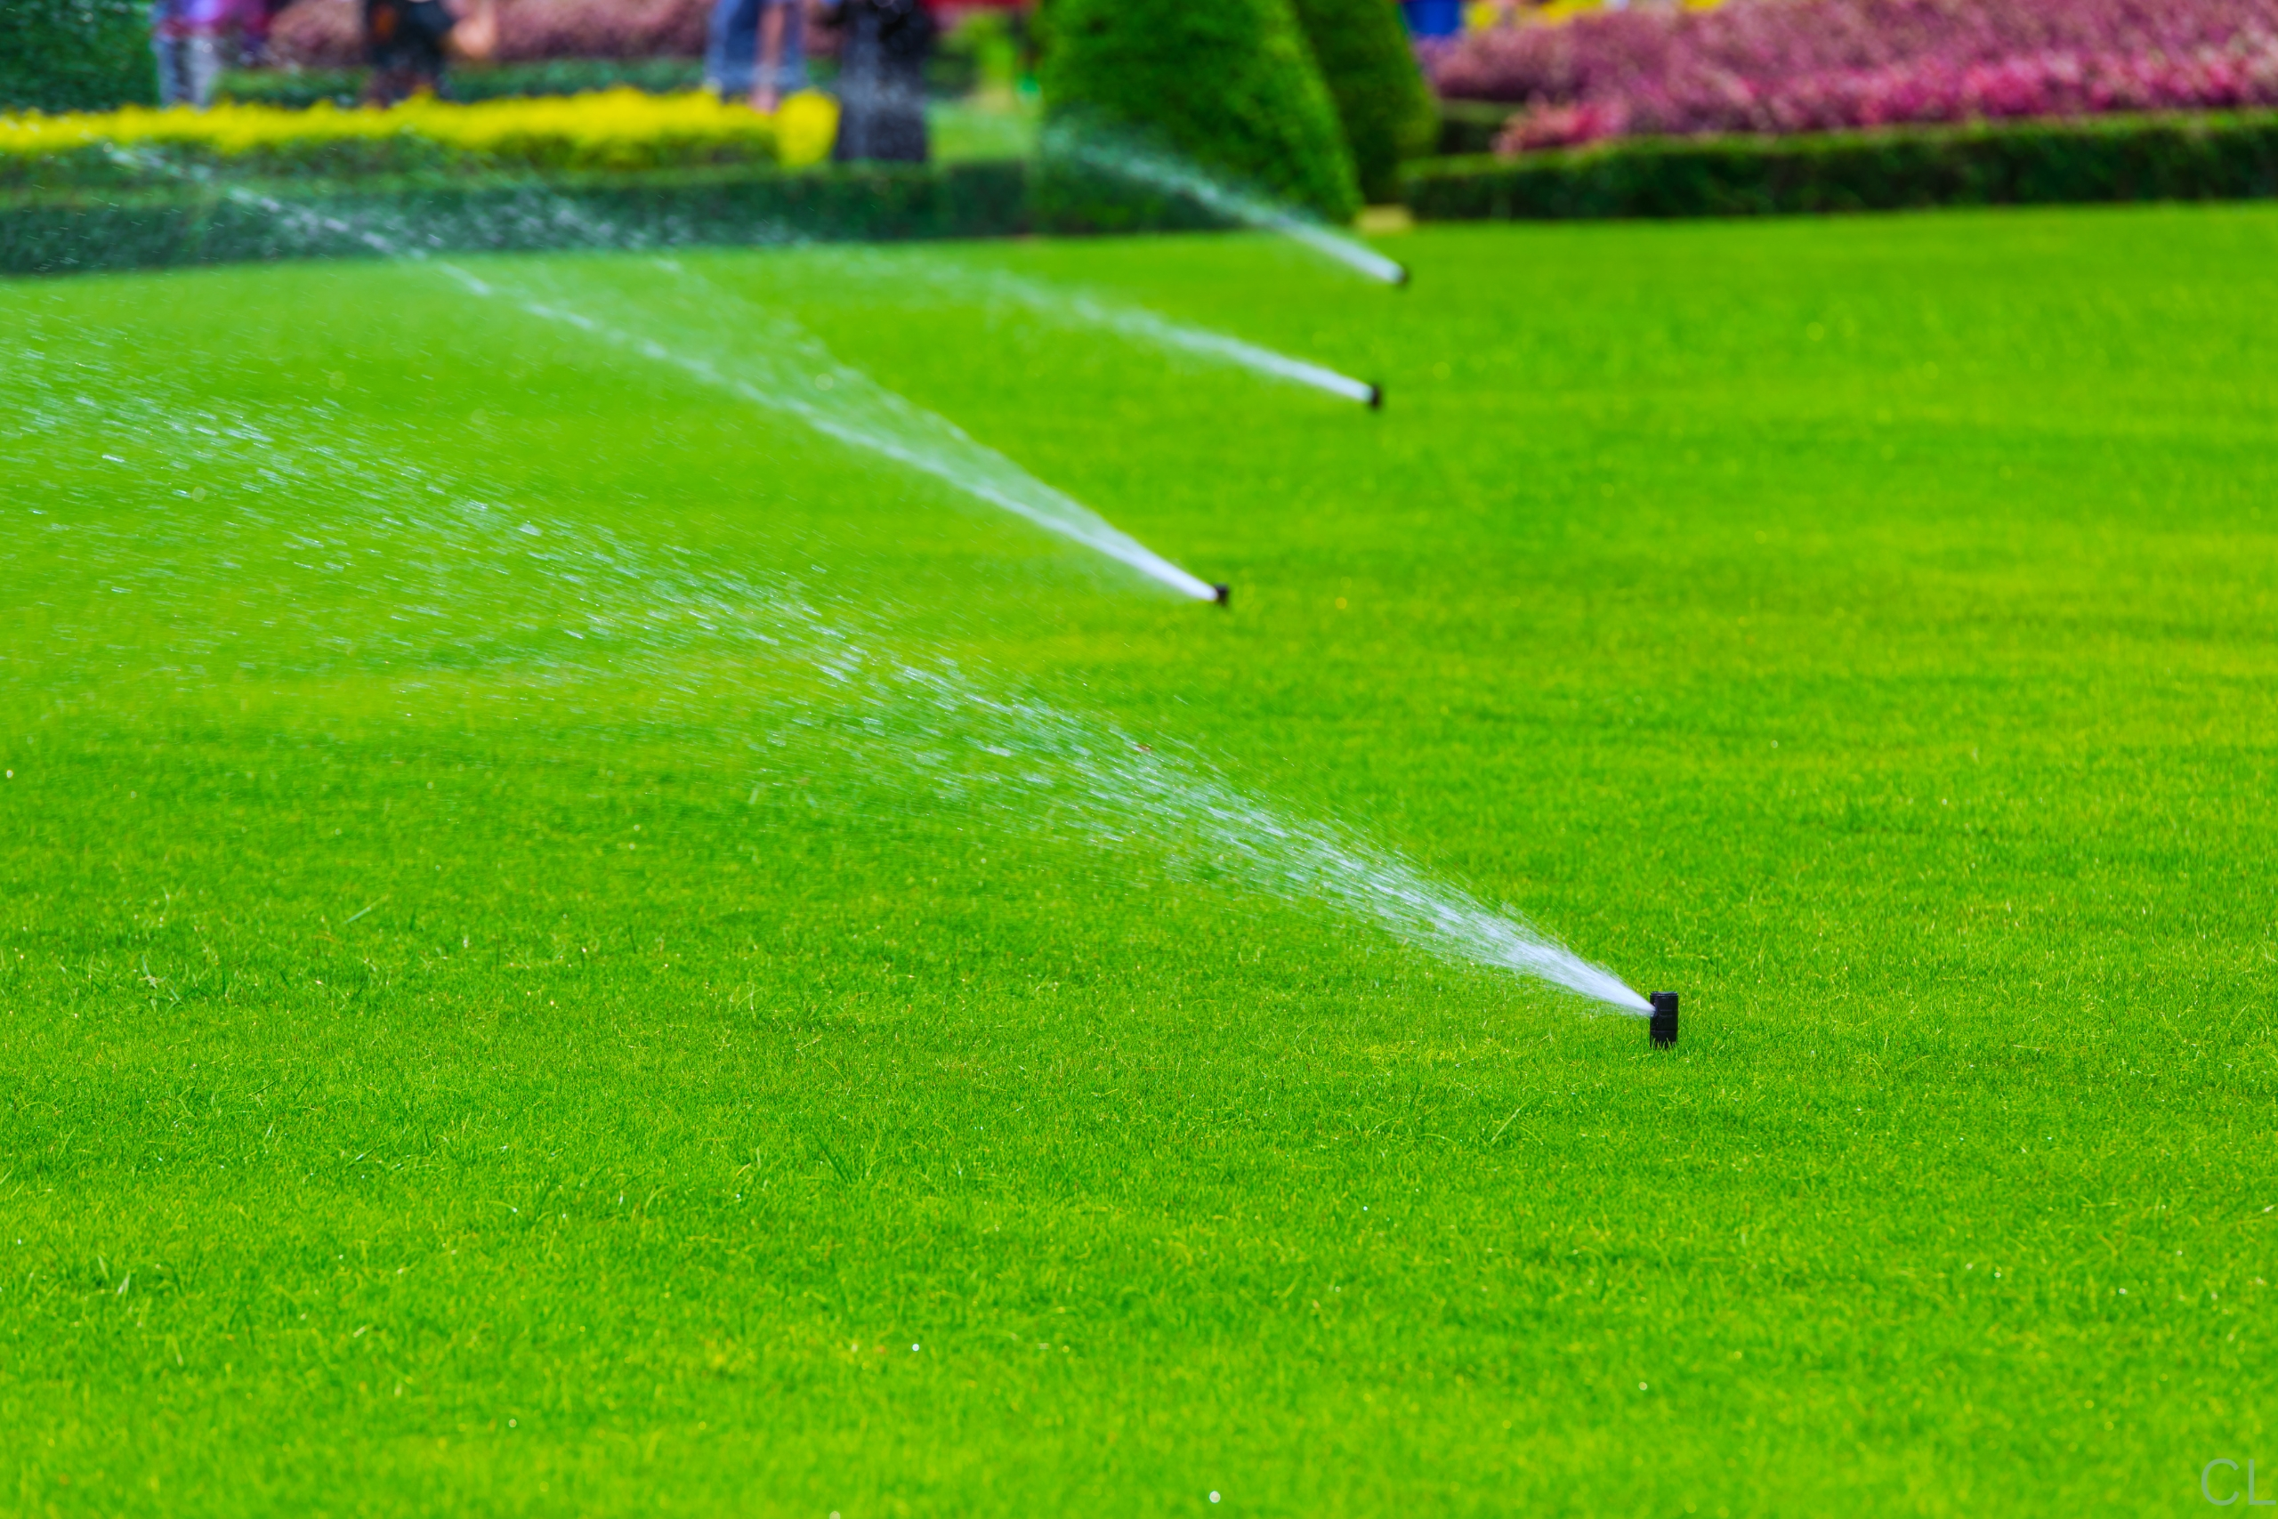
Irrigation on Shelter Island
DISCUSSION DRAFT
How to care for your property, obey the laws
and protect our natural resources.

Slide 2

The Pros of Irrigation
Irrigation can be used to promote and sustain the health and growth of vegetation to the benefit of our community.
Vegetation aids and promotes the absorption of precipitation into our aquifer.
Reduces and prevents runoff into our estuaries and bays, caused by Hydrophobic soil conditions.
Helps prevent waxing and soil hardening aiding to maintain fertile, aeration and absorbent soils profiles.
Vegetation acts as a filtering system to help remove contaminants.
Reduces danger of forest or brush fire.

Slide 3
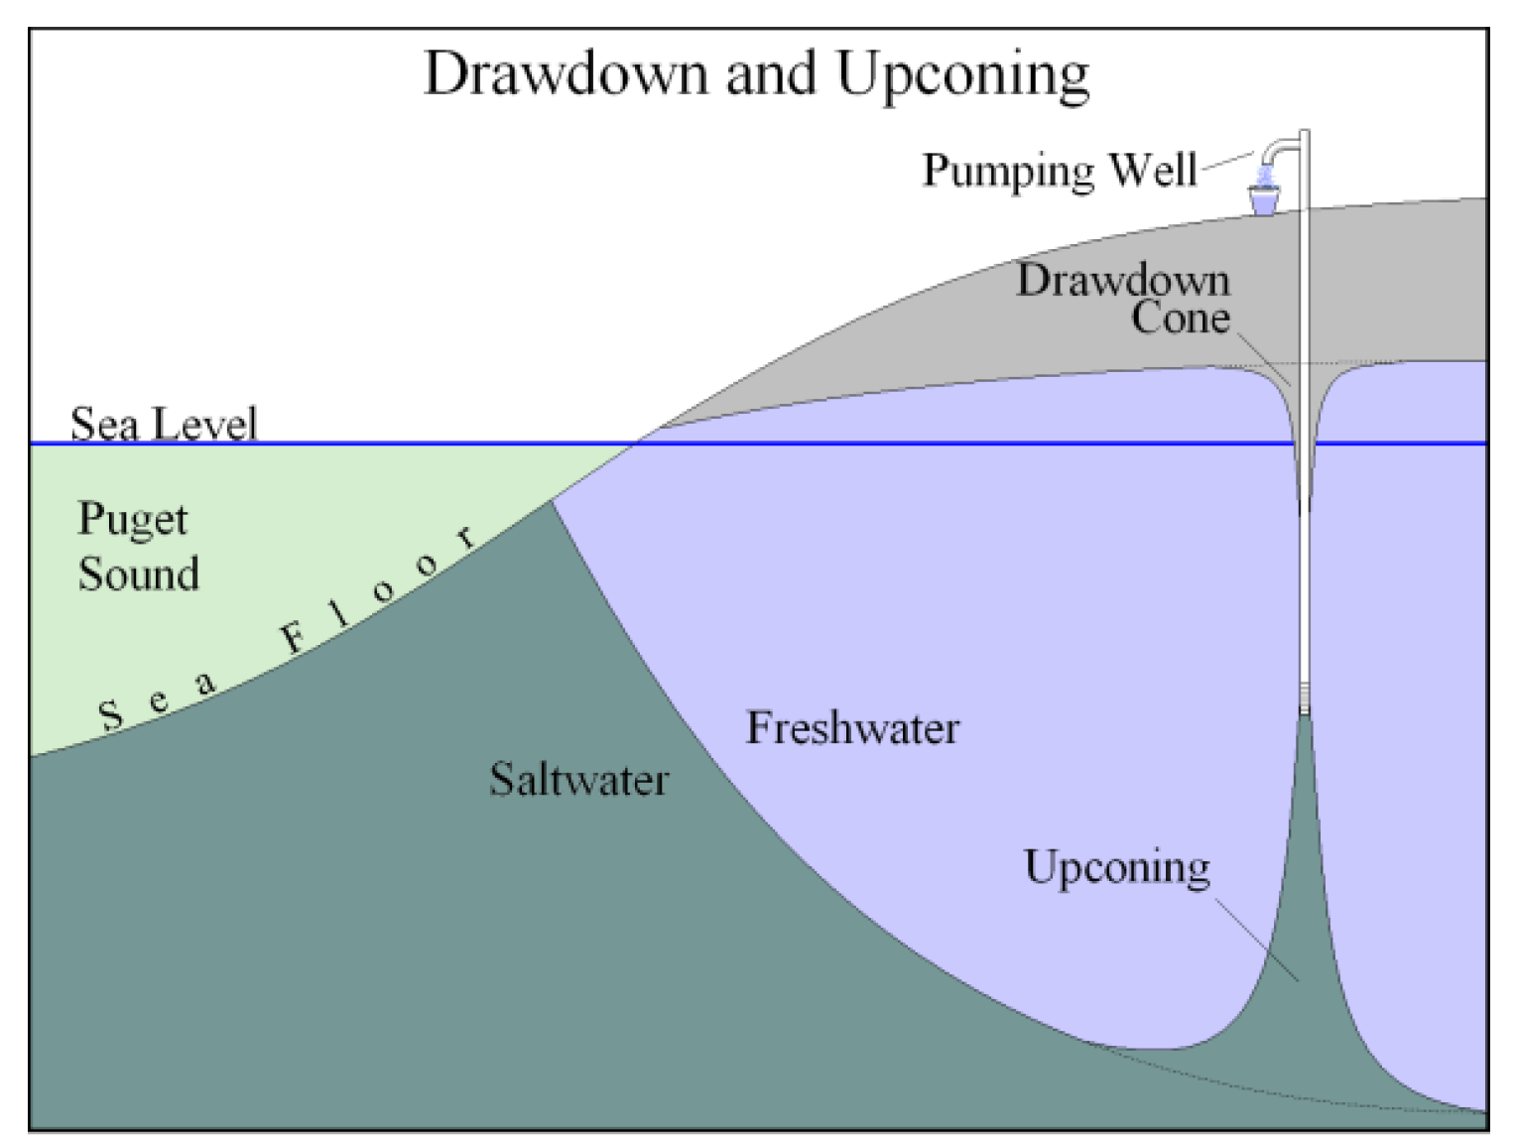
The Cons of Irrigation
Excessive Pumping - for irrigation or other purposes in fragile near shore areas can lead to “up-coning” where the salt water underneath our fresh water supply is pulled into the fresh water layer – and can lead to permanent salting of your own wells and those of your neighbors.

Slide 4
Its about Balance, Moderation
and Timing!

Slide 5
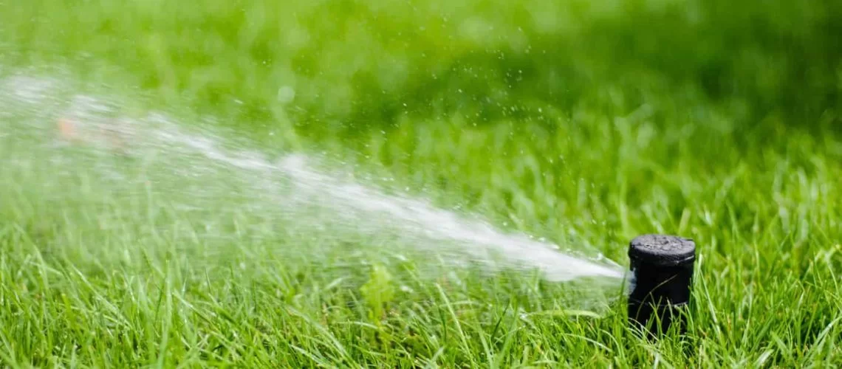
What irrigation is permitted on Shelter Island?
Turf Irrigation systems
All turf irrigation systems require a permit from the Town with annual renewal.
Some grandfathered turf systems that use well-drawn water still exist and are exempted from certain regulations.
New turf systems require water to be drawn from a cistern.
Cisterns can be filled in two ways:
Collection of no more than 10% of the properties impermeable solid surfaces.
Off-island trucked-in water.
Note: Trucked-in water typically comes from neighboring towns on the forks and there is a looming risk that those towns will prohibit these non-resident uses. Accordingly, cisterns using off-island trucked-in water may need to revert to precipitation collection in the future.
New turf irrigation systems must be installed by a licensed professional and must conform to various water saving features such as programmable timers and moisture sensors.

Slide 6
Dripline Irrigation Systems:
Dripline irrigation systems may use well drawn water if operating within the specified parameters.
The drip system shall not emit more than one gallon per hour per emitter/lineal foot with a maximum 1500 emitters; a permit is required for systems with more than 1500 emitters
The drip system must be a on a timer; and the drip system should be programmed to allow for no more than one hour for any three day period per zone. Shorter more frequent cycles may be more optimal.
The drip system shall be covered with mulch to reduce evaporation.
In the Near Shore zones, any drip system with over 250 emitters shall meet the following additional standards:
Require a permit.
Shall be equipped with a master valve, time clock and moisture sensor.
Fed only from a cistern.
Need clarification on these regulations – especially 2015 amendments regarding number of emitters without a permit.
Need estimate to translate emitters parameter to approx. number of feet of dripline
Temporary driplines for new plantings
Irrigation with longer drip lines is allowed to establish new plantings for a period of 150 days, only between 5:00 p.m. and 9:00 a.m.
After the 150 day period, the driplines should be removed.
A permit is required for this temporary exemption.

Slide 7
Optimal Irrigation System Operation
Rather than programming longer times per zone and immediately starting one zone after another – consider the following:
10 minutes per zone
20 minutes rest between zones
Allow to cycle through all zones X number of times to complete irrigation for the day.

Slide 8
BEWARE
Many driplines systems on Shelter Island do not conform to the legal requirements and the homeowner is subject to fines for violations. Many of these were likely installed for new plantings without a permit but have never been removed and may or may not continue to be used illegally.
If your water is provided from a community central well such as West Neck and Shelter Island Heights, you are subject to similar irrigation rules as part of your contract. A central well do not obviate the need to conserve water! The water is still coming from an aquifer with inherent limitations.
Note: Suffolk County has adopted strict new irrigation rules but they apply only to those using water provided by Suffolk County Water Authority (SCWA).

Slide 9
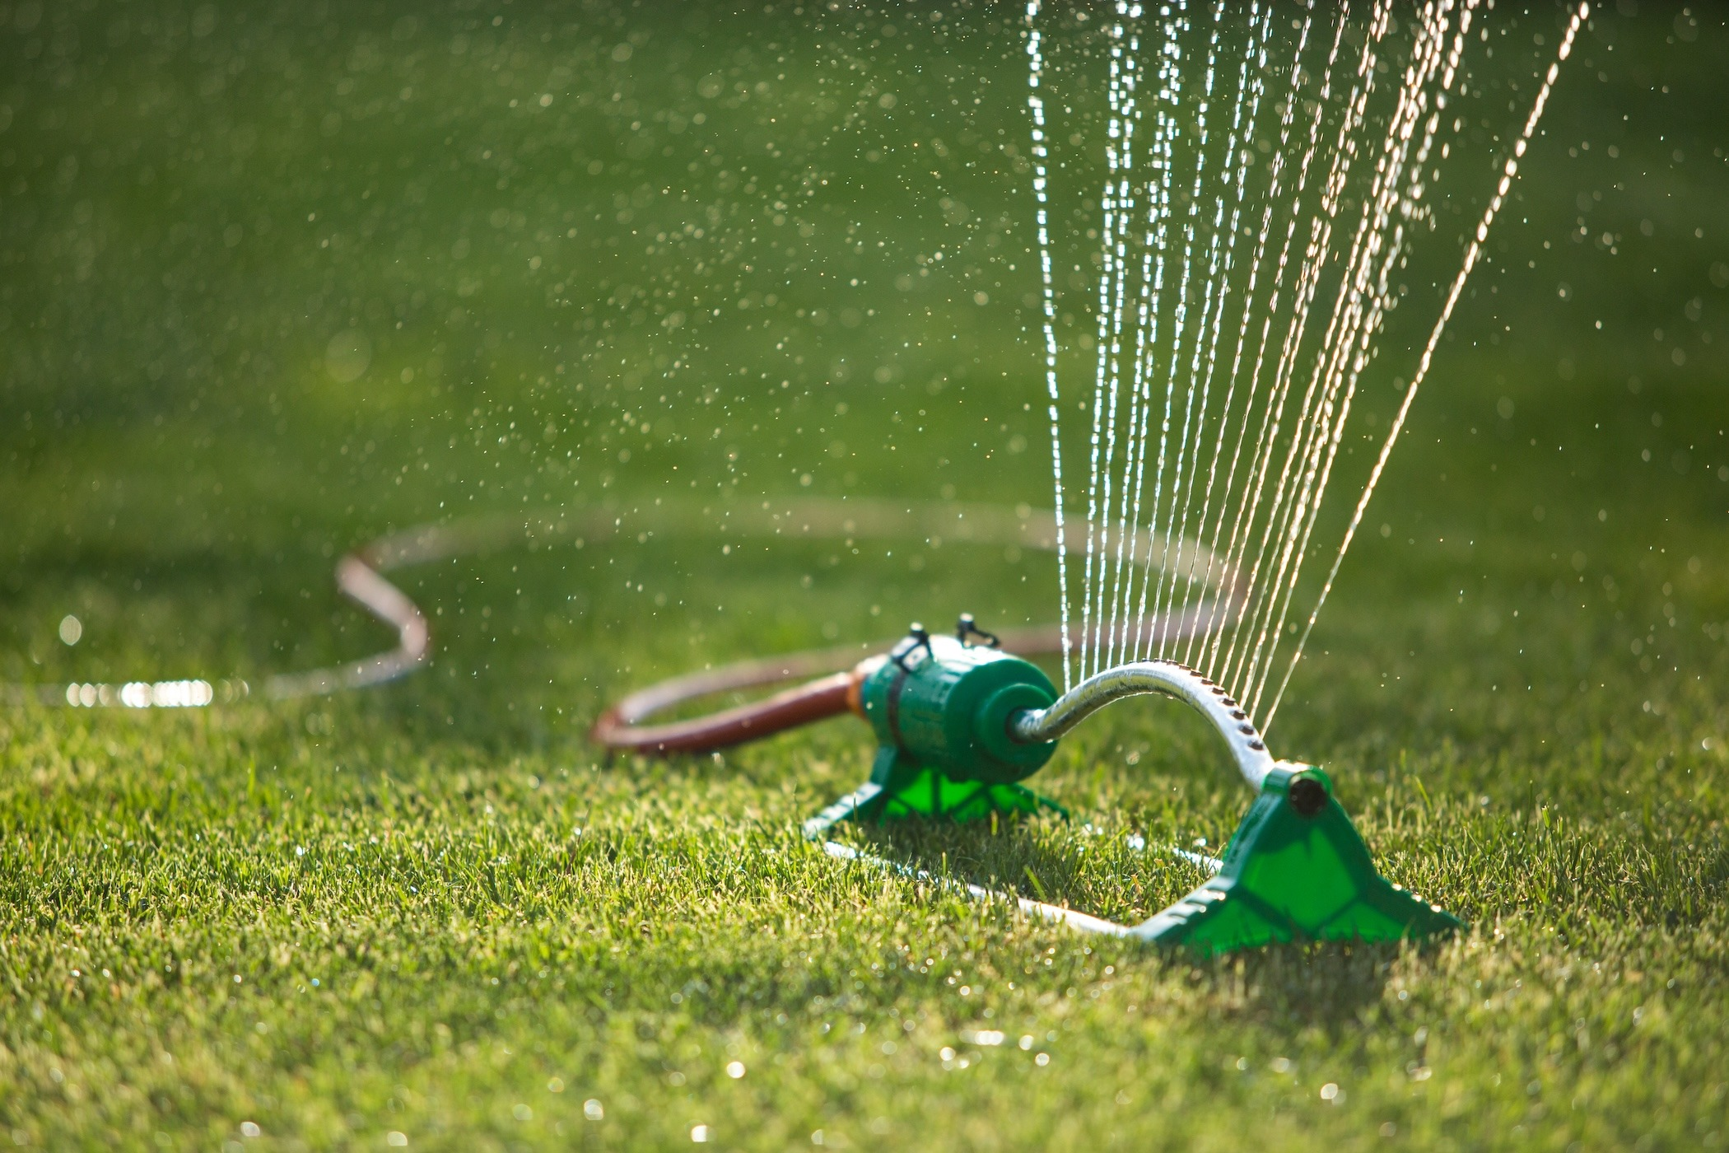
Exempt irrigation
Hand watering
Temporary movable sprinklers
Best practices for movable sprinklers:
Water only during the hours of 9 p.m. and 8 a.m.
Water only up to 15 minutes per area. 4 times per day. 20 minutes rest between areas before the next watering. (clarification needed?)
Space out watering to be approx. every 3 days per area.
Do not run more than one sprinkler at a time.

Slide 10
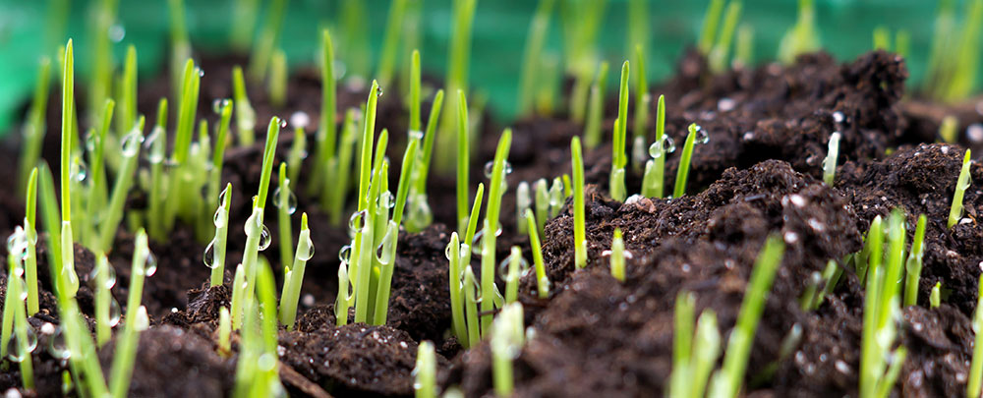
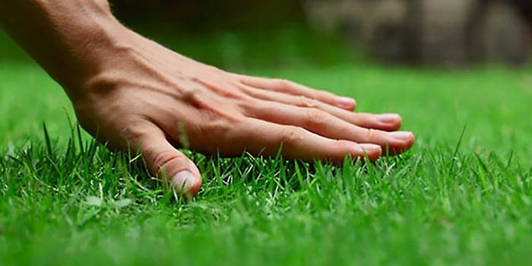
Effective Turf Watering
Establishing a New Grass seed Lawn.
Avoid late season establishment between July and August 15th.
Seeds applied between July and Augst are considered a Dormant
Seeding and will not be watered as environmental conditions are the worst time for growing seed. High temperatures combine with high heat, with added disease pressure makes growing grass very difficult and not worth the water expenditure.
Watering existing turf
Water deeply and infrequently. The goal is to
establish a strong root deep system.
Repeated shallow waterings cause shallow rooting.
Your soil type will indicate how much water and
what rate you apply it at. In order to get enough
water into the zone repeated nightly watering of
one zone per night may be required.

Slide 11
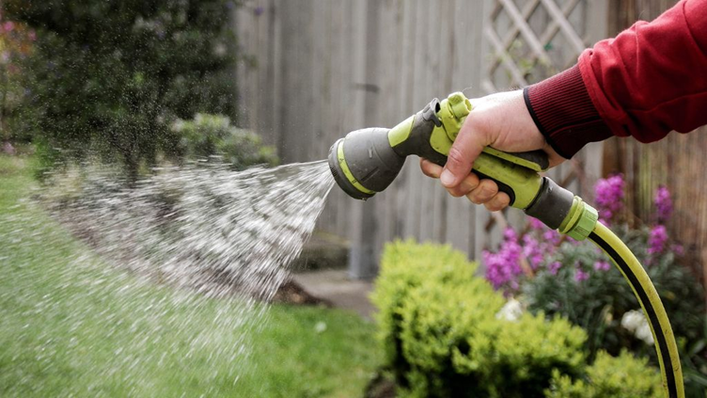
Be a conscientious neighbor. Your water use effects those that lives around you too!
Maintain a healthy habitat but be realistic about how green things really need to be in the hot and dry summer months when precipitation often falls off and our wells may have less water.

Slide 12
Drought Conditions
The Town has the ability to limit and override permitted irrigation during declared times of drought.
Specify levels?

Slide 13
Consider using native plantings and retain healthy trees on your property
The use of native and drought resistant plantings require less or little watering once roots have taken hold.
Native plantings help maintain a natural habitat and are less prone to disease.
Tree roots hold bind and stabilize soil which helps reduce run-off
Trees provide shade to reduce temperatures and reduce evaporation.

Slide 14
Looking Forward
Alternative irrigation and water capture models are evolving that are worth exploring – especially when doing new builds, renovations and garden plantings:
Shallow drainage fields for irrigation: also known as a leach field, is a network of pipes and trenches that distributes wastewater to the soil.
Rain gardens instead of lawn: a garden that lies below the level of its surroundings, designed to absorb rainwater that runs off of a surface such as a patio or roof.
Create one more more swales if your property is conducive: A swale is a shallow, broad, and vegetated channel that collects water to allow for increased absorption.
Dry wells are required for new construction and renovation to capture roof water. Consider installing a drywell if you don’t already have one. As much as 50% of precipitation never reaches the aquifer due to evaporation and runoff among other factors.
Consider installing a meter on your pump to better understand your water usage and help identify leaks if using installed irrigation.

